Slide 1

The Green Environment Services Co. Op. Soc. Ltd.
Continuous Learning Program

Slide 2
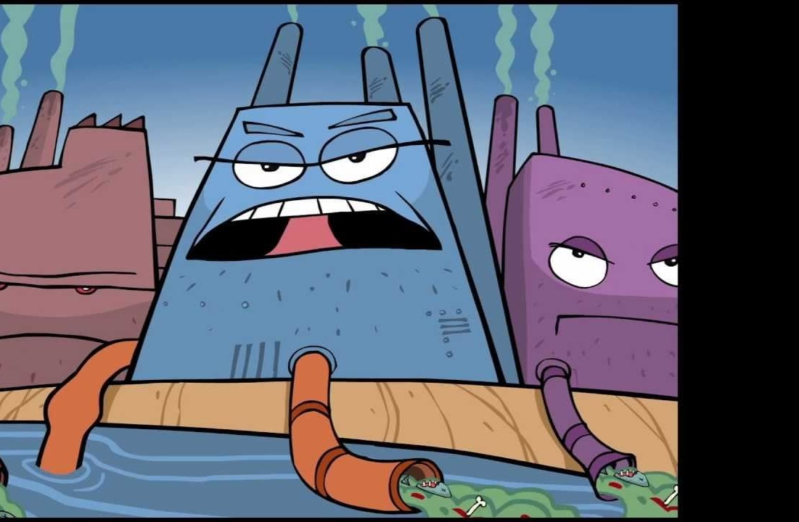
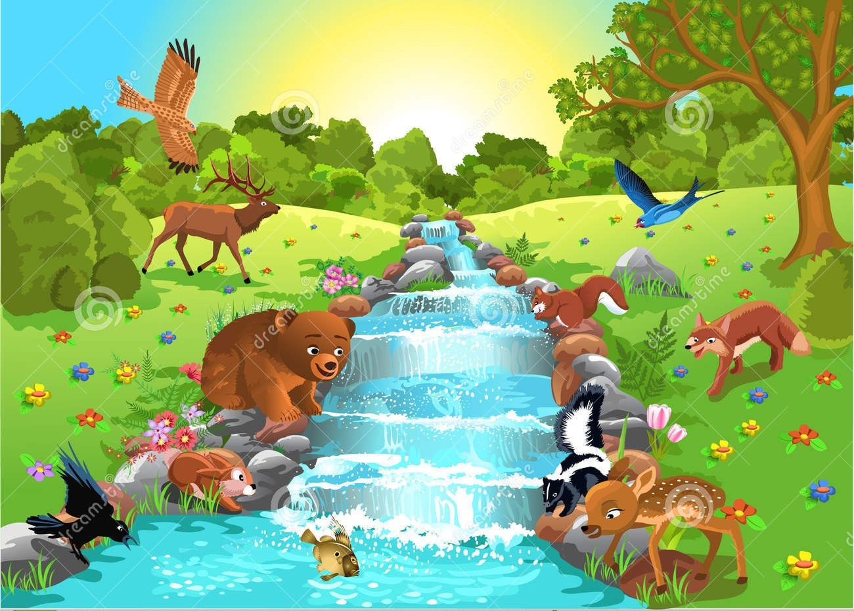
Wastewater Treatment
Journey of Treatment and Return to the Environment

Slide 3
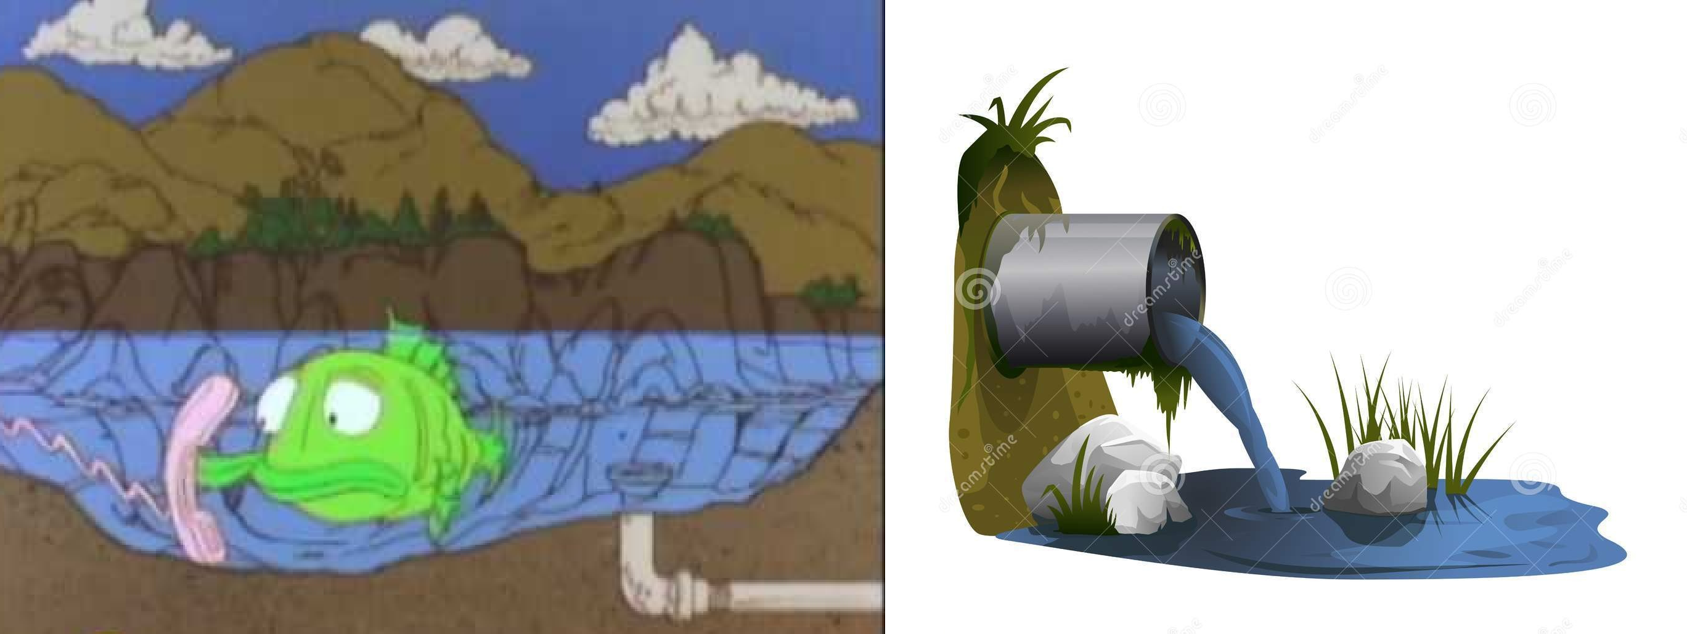
What is Wastewater?
Wastewater is a term that is used to describe waste material that includes industrial liquid waste that is collected and treated at wastewater treatment plants.

Slide 4
What is an ETP?
ETP (Effluent Treatment Plant) is a process design for treating the industrial wastewater for its reuse or safe disposal to the environment.
Influent: Untreated industrial waste water.
Effluent: Treated industrial waste water.
Sludge: Solid part separated from waste water by ETP.
INFLUENT
ETP
EFFLUENT
SLUDGE

Slide 5
Need of ETP
To clean industry effluent and recycle it for further use.
To reduce the usage of fresh/potable water in Industries.
To cut expenditure on water procurement.
To meet the Standards for emission or discharge of environmental pollutants from various Industries set by the Government and avoid penalties.
To safeguard environment against pollution and contribute in sustainable development.

Slide 6
Design of ETP
The design and size of the ETP depends upon:
Quantity and quality of the discharge effluent.
Land availability.
Monetary considerations for construction, operation & maintenance.
Area dimension depends on:
Quality of wastewater to be treated,
Flow rate
Type of biological treatment to be used.
In case of less available land, CETP (Common Effluent Treatment Plant) is preferred over ETP

Slide 7
Treatment & Mechanisms of ETP
Treatment levels:
Preliminary
Primary
Secondary
Tertiary (or advanced)
Treatment mechanisms:
Physical
Chemical
Biological

Slide 8
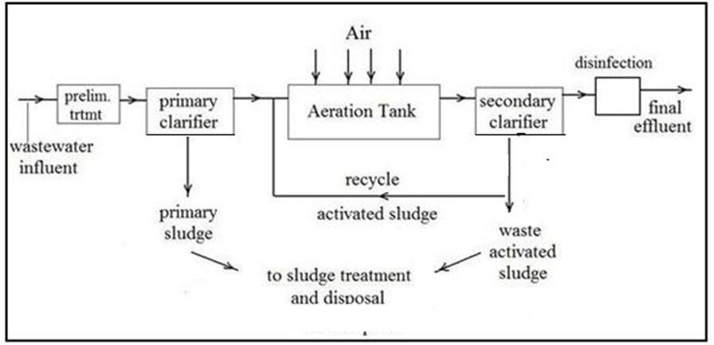
Flow chart for ETP

Slide 9
Preliminary Treatment level
Purpose : Physical separation of big sized impurities like cloth, plastics, wood logs, paper, etc.
Common physical unit operations at Preliminary level are:
Screening: A screen with openings of uniform size is used to remove large solids such as plastics, cloth etc. Generally maximum 10mm is used.
Equalization: To collect and homogenize the quality of effluent according to the further treatment requirement.

Slide 10
Methods used in Preliminary treatment
Bar screens
Skimming
Grit Chamber
Equalization

Slide 11
Screen Chamber
Screen chamber removes plastics, plant leaves, logs of wood, rags and other coarse floating material.
The effluent is passed through the bar screens for rag removal. In this section, automatic bar screen cleaners remove large solids (rags, plastics, etc.) from the effluent. The collected material is placed in dumpsters to be taken later to the landfill.

Slide 12
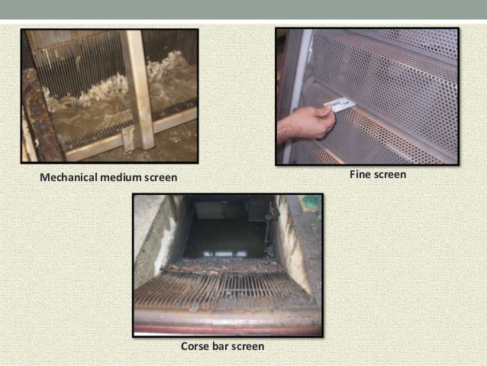

Slide 13
Skimming Tank
Fats, waxes, fatty acid, soap, minerals and vegetable oil present in waste water are collectively called as oil and grease. As oil and grease are lighter than water they are normally separated by natural flotation .
The bubbles of air are passed on the bottom of the tank and floating matter rises and remain on the surface of wastewater which can be separated easily.

Slide 14
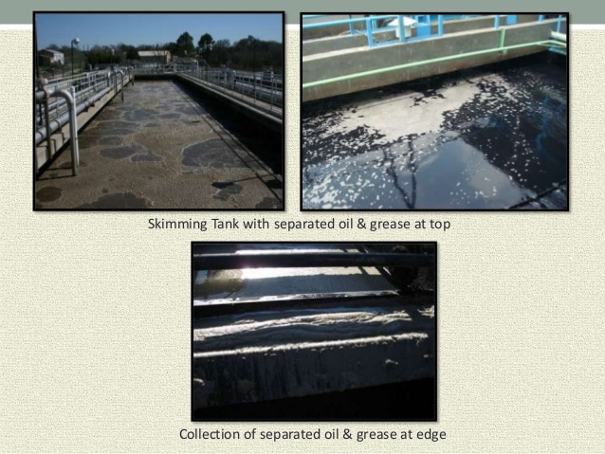

Slide 15
Grit chamber
Grit include sand, ash, egg shell etc . of diameter less then 0.2 mm.
These tanks reduce the velocity (0.3 m/s) of the effluent so that heavy particles may fall to the bottom. The solids are pumped which separates the water from the grit while the water moves onward. The grit (mostly inorganic solids) goes to a dumpster which is taken to a landfill. There are two complete grit removal systems which are rotated in operation for equal hours.

Slide 16
EQUALIZATION TANK
Equalization makes the waste water homogenous.
Retention time depends upon the capacity of treatment
plant. (Generally 8-16 hours)
EQUALIZATION TANK
Influent
Further treatment
Air for diffusion

Slide 17
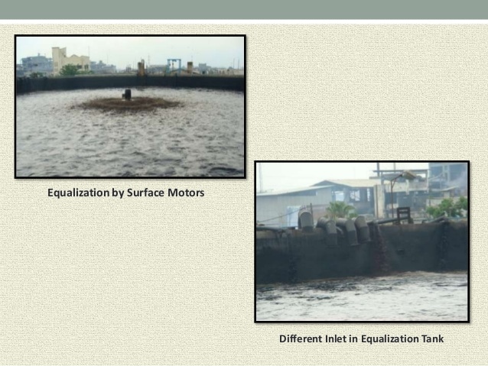

Slide 18
Primary Treatment
Purpose: Removal of floating and settleable materials such as suspended solids and organic matter.
Methods: Both physical and chemical methods are used in this treatment level.
Chemical unit processes:
Chemical processes use the addition of chemicals to the wastewater to bring about changes in its quality.
Example: pH control, coagulation, chemical precipitation and oxidation.

Slide 19
pH Control:
To adjust the pH in the treatment process to make wastewater pH neutral.
For acidic wastes (low pH): NaOH, Na₂CO₃, CaCO₃or Ca(OH)_{2.}
For alkali wastes (high pH): H₂SO₄, HCl.
Chemical coagulation and Flocculation:
Coagulation refers to collecting the minute solid particles dispersed in a liquid into a larger mass.
Chemical coagulants like Al₂(SO4)₃ {also called alum} or Fe₂(SO4)₃ are added to wastewater to improve the attraction among fine particles so that they come together and form larger particles called flocs.
A chemical flocculent (usually a polyelectrolyte) enhances the flocculation process by bringing together particles to form larger flocs , which settle out more quickly.
Flocculation is aided by gentle mixing which causes the particles to collide.

Slide 20
Clarriflocculator:
In the clarriflocculator the water is circulated continuously by the stirrer.
Overflowed water is taken out to the aeration tank.
The solid particles are settled down, and collected separately and dried; this
reduces SS, TSS.
Flocculation provides slow mixing that leads to the formation of macro flocs, which then settles out in the clarifier zone.
The settled solids i.e. primary sludge are pumped into sludge drying beds.

Slide 21
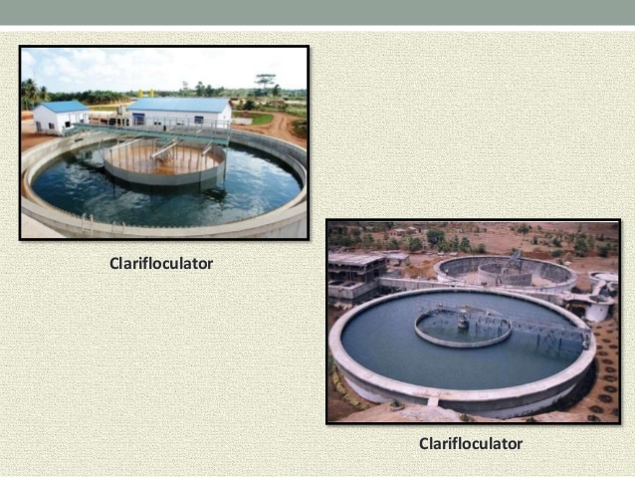

Slide 22
THANK YOU

